Slide 1

Athlete Performance Tracking System
A comprehensive web-based platform delivering real-time performance analytics for cricket and football athletes through intelligent data processing and interactive visualization

Slide 2
The Challenge & Solution
❌ The Problem
✅ Our Solution
Sports teams struggle with fragmented athlete data across multiple systems. Performance metrics, injury histories, and fitness levels exist in isolated databases, making comprehensive player evaluation time-consuming and error-prone.
A unified performance tracking system that automatically aggregates multi-sport data, calculates intelligent ratings, and delivers insights through an intuitive interface powered by modern web technologies.
Automated rating calculations
Manual data aggregation delays decisions
Real-time filtering and search
Inconsistent rating methodologies
Visual performance comparisons
No real-time performance insights
Multi-sport architecture
Cross-sport comparison impossible

Slide 3
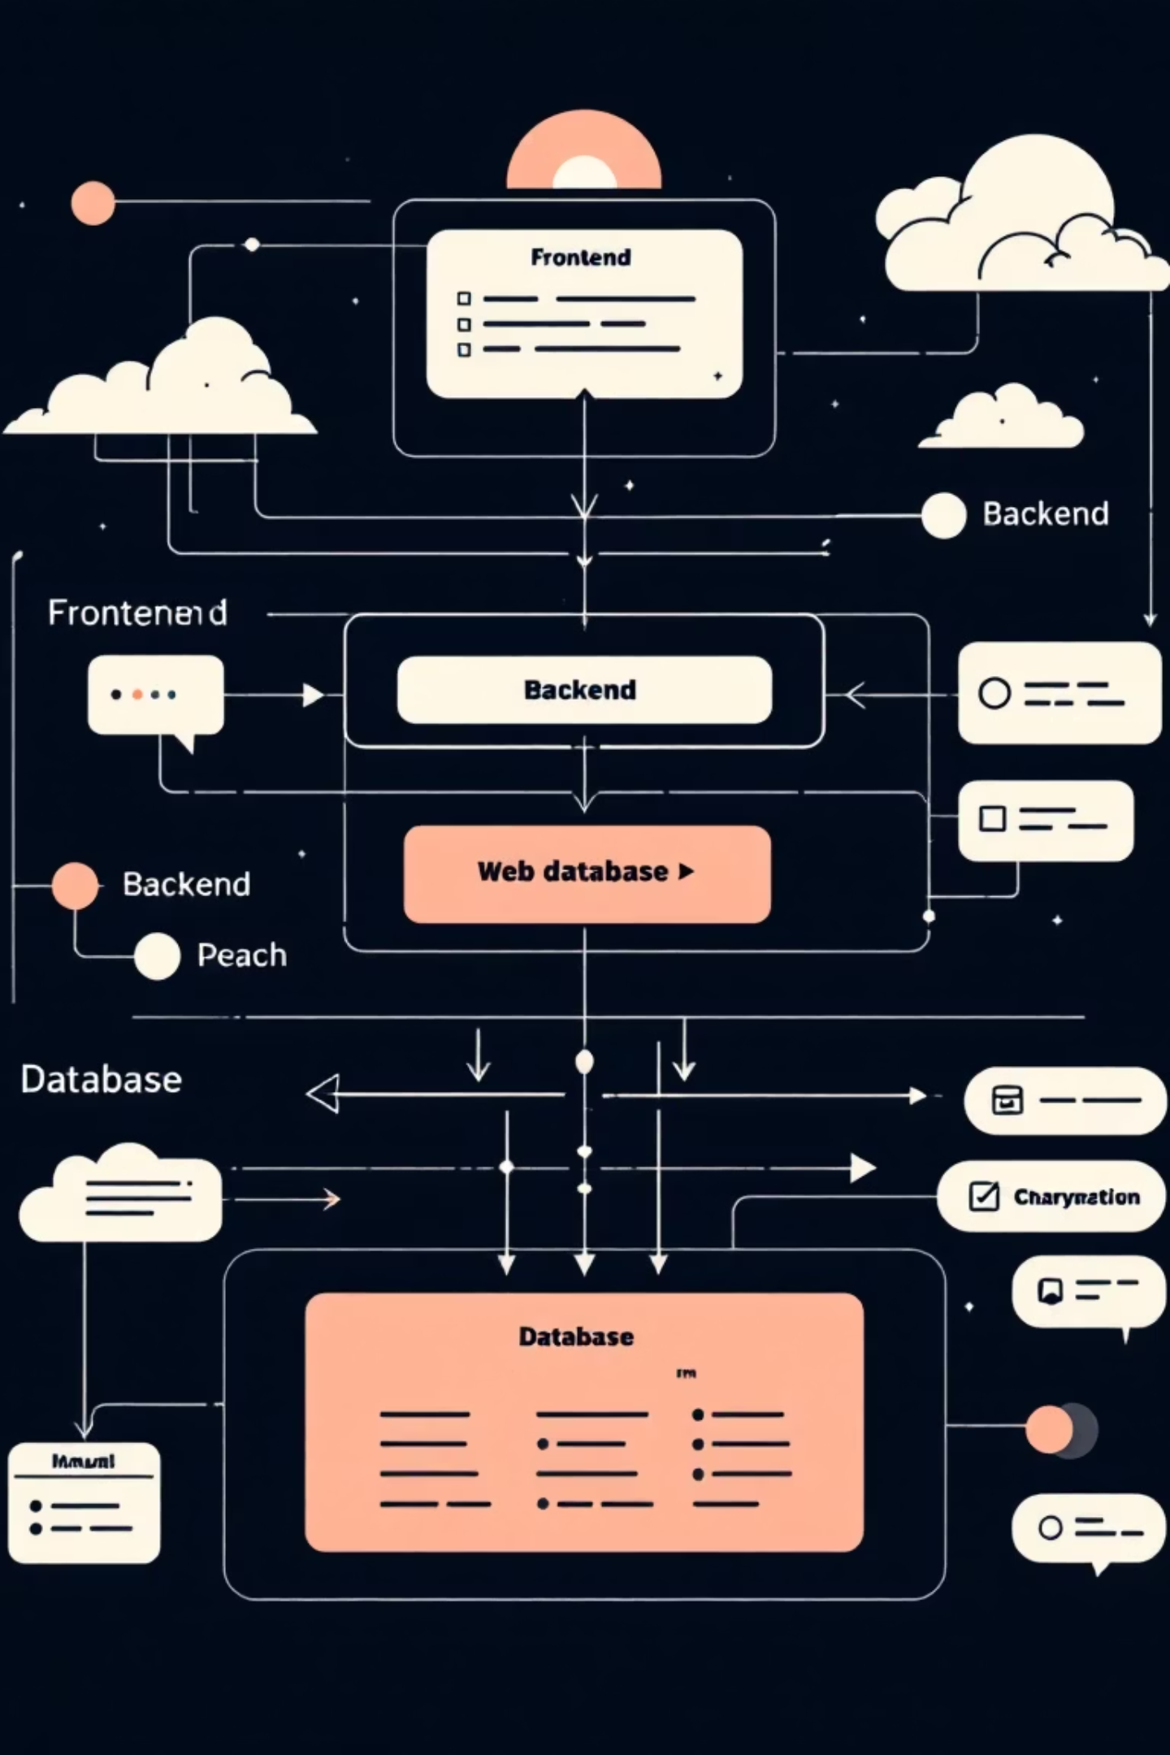
System Architecture
A modern three-tier architecture built on industry-standard technologies, ensuring scalability, maintainability, and optimal performance
01
02
Presentation Layer
Application Layer
React 18.2.0 + Recharts on port 3001 - Interactive UI with live filtering, animated charts, and responsive design
Node.js + Express.js REST API on port 5000 - Handles requests, executes business logic, calculates ratings
03
Data Layer
PostgreSQL databases - Separate schemas for cricket and football with 560+ athletes and 1,400+ performance records

Slide 4





Frontend Excellence
Smart Search & Filter
Real-time player search with instant results, multi-criteria filtering by position, fitness level, and performance metrics
Interactive Visualizations
Dynamic bar charts and rating circles powered by Recharts, with smooth animations and responsive hover states
Sport Toggle
Seamless switching between cricket and football datasets with consistent UI patterns and instant data refresh
Modern UI/UX
Glass-morphism design with gradient overlays, subtle shadows, and fluid transitions for professional polish

Slide 5





Backend Intelligence
RESTful API
Rating Engine
Four core endpoints delivering athlete lists and detailed profiles for both sports
statsGenerator.js processes performance data using position-specific algorithms
Injury Analysis
Fitness Tracking
Impact calculator weighing severity and recovery time to adjust overall ratings
Independent fitness scores from 60-100% influence player availability
API Endpoints: GET /api/athletes | GET /api/athletes/:id | GET /api/footballers | GET /api/footballers/:id

Slide 6

Overall Rating
Component Breakdown
Performance Score (0-100): Position-specific metrics weighted by importance - batting average, strike rate, goals, assists, defensive actions
Injury Impact (0-40): Calculated as severity level × recovery time, with recent injuries weighted more heavily
Fitness Level (60-100%): Independent metric tracking current physical condition and training readiness
The algorithm ensures fair comparisons across positions while accounting for health factors that impact game-day performance. All calculations run server-side with sub-100ms response times.

Slide 7
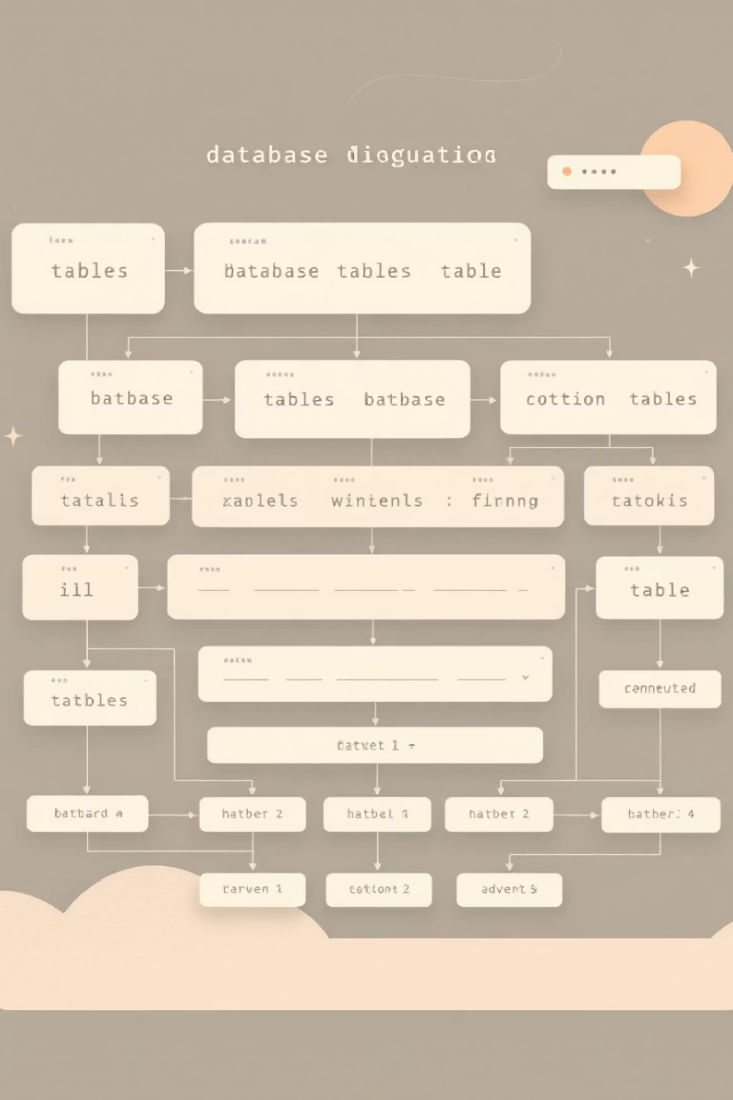
Database Architecture
🏏 Cricket Database
⚽ Football Database
cricket_performance schema
football_performance schema
athletes table: 300 player records with demographic and position data
footballers table: 260 player profiles including position specializations
stats table: 900+ performance entries tracking batting, bowling, and fielding metrics
footballer_stats table: 500+ match statistics covering goals, assists, defensive actions
injuries table: Historical injury records with severity ratings and recovery timelines
footballer_injuries table: Comprehensive injury history with impact assessments
Optimized with indexes on player_id and date columns for fast JOIN operations
Identical structure enables code reuse and consistent query patterns across sports

Slide 8
Data Flow & Communication
User Interaction
1
Browser sends HTTP GET request to API endpoint with query parameters for filtering and search
2
API Processing
Express.js receives request, validates parameters, routes to appropriate controller function
Database Query
3
SQL SELECT with JOINs across athletes, stats, and injuries tables retrieves raw data
4
Rating Calculation
statsGenerator.js processes records, applies position-specific formulas, computes injury impact
JSON Response
5
Formatted payload with calculated ratings, formatted stats, and enriched player data returns to frontend
6
UI Rendering
React components update state, Recharts renders visualizations, animations enhance transitions

Slide 9

Ready for Demo
🎯 Live Filtering
💯 Rating Calculations
Watch real-time search narrow down 560 athletes to relevant matches instantly
Explore how injury history and performance metrics combine to produce final scores
📊 Dynamic Charts
See performance visualizations update smoothly as you toggle between cricket and football

